Slide 1
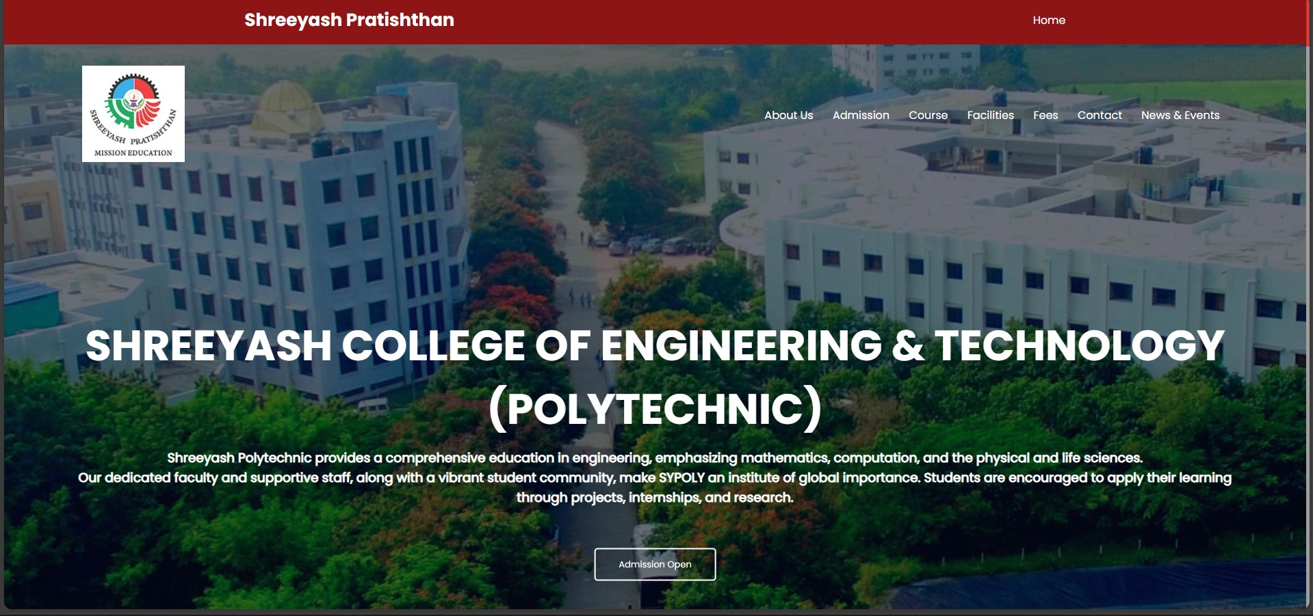
Website Development Project
- Aniket Khandagale

Slide 2

Favicon:
Icon for the website displayed in the browser tab.
Brand Bar:
Displays the Website name and Home navigation link.
Navigation Bar:
Provides navigation links for easy access to different sections of the website.

Slide 3
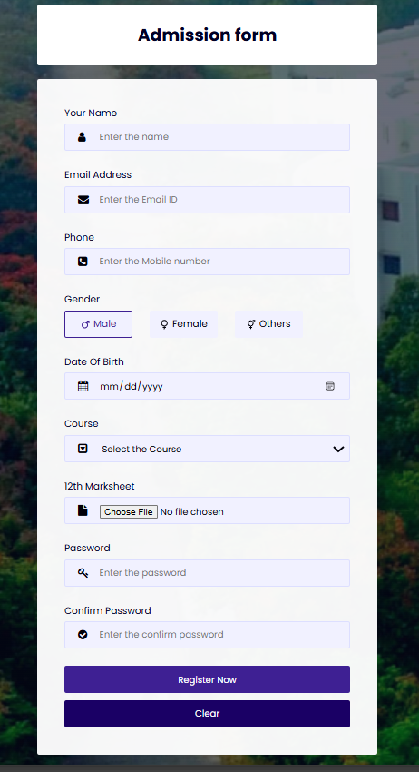
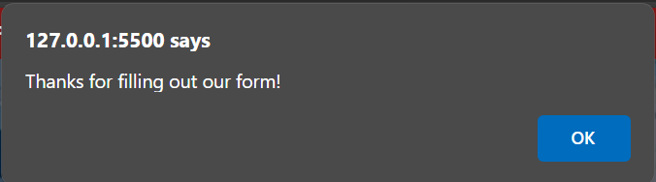
Admission form functionality along with navigation, branding elements, Input Fields, Gender Selection, Date of Birth, Course Selection, File Upload, Password Fields, Submit and Clear Buttons
JavaScript for Sending Email:
<script>
function sendmail(){
Email.send({}).then(
message => alert("Thanks for filling out our form!")
);
}
</script>

Slide 4

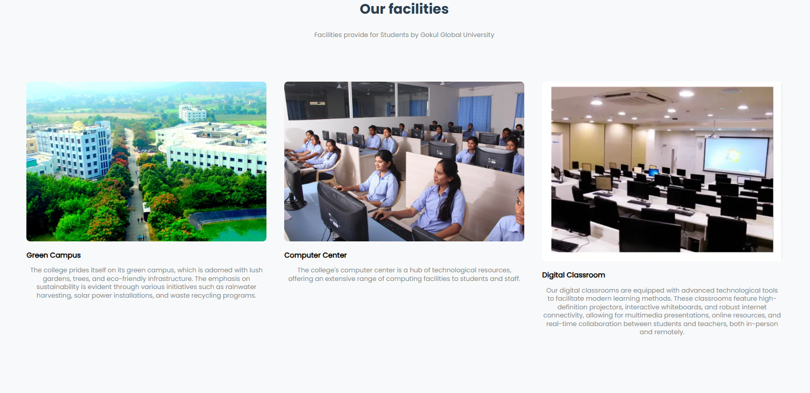
Course Section:
Lists various diploma programs offered by the institution.
Facilities Section: Highlights key facilities provided by the institution.

Slide 5
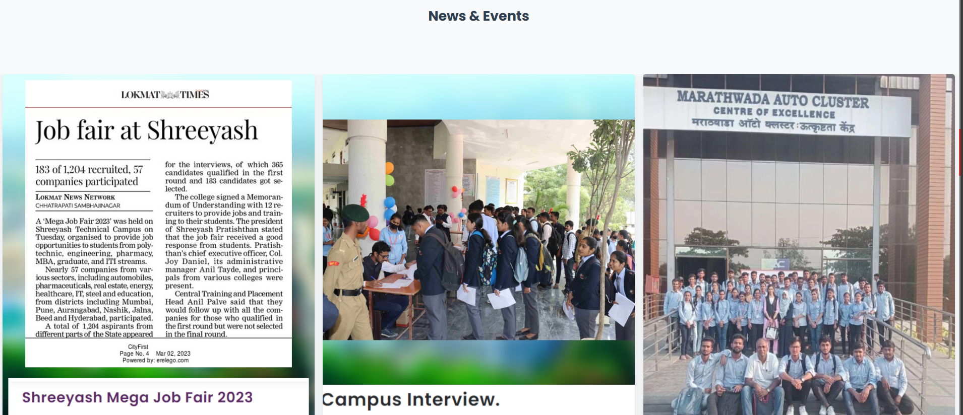
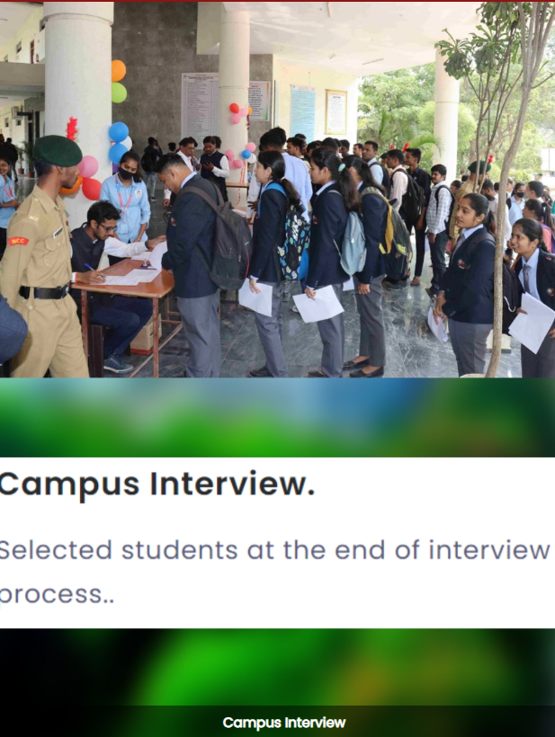
News & Events:
Showcases upcoming events and news.
CSS:
.campus-col img {
width: 100%;
height: 100%;
display: block;
border-radius: 8px;
transition: transform 0.3s ease-in-out;
}
Styles the images within .campus-col to occupy the entire width and height of their container, with a border radius of 8px for rounded corners. Applies a smooth transition effect on the image's transform property for a subtle hover effect.

Slide 6
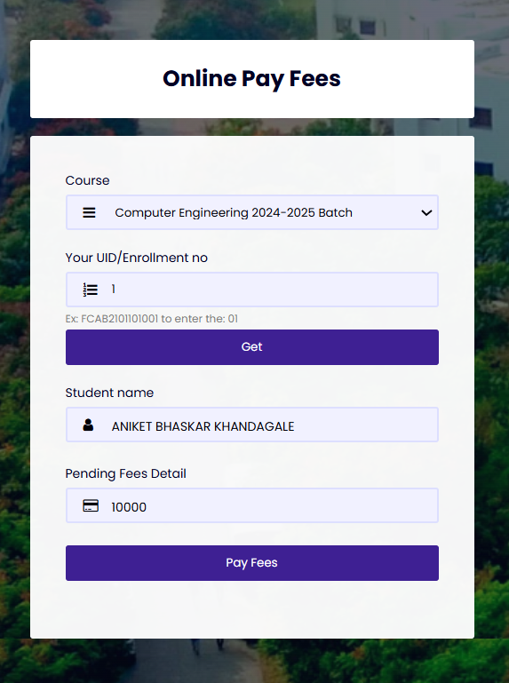
Online Pay Form:
Allows students to pay fees online.
Fields for selecting a course, UID/Enrollment number, student name, and pending fees detail.
Buttons to submit the form and pay fees.
Script:
JavaScript functions for showing/hiding the navigation menu.
Function to send a confirmation email after payment.
External script for sending emails via SMTP.
(Sending email directly from the browser without needing a backend server is now possible using SMTP. js. SMTP. js is a JavaScript SMTP client library that allows you to send mail through client-side JavaScript by wrapping the SMTP protocol.)

Slide 7
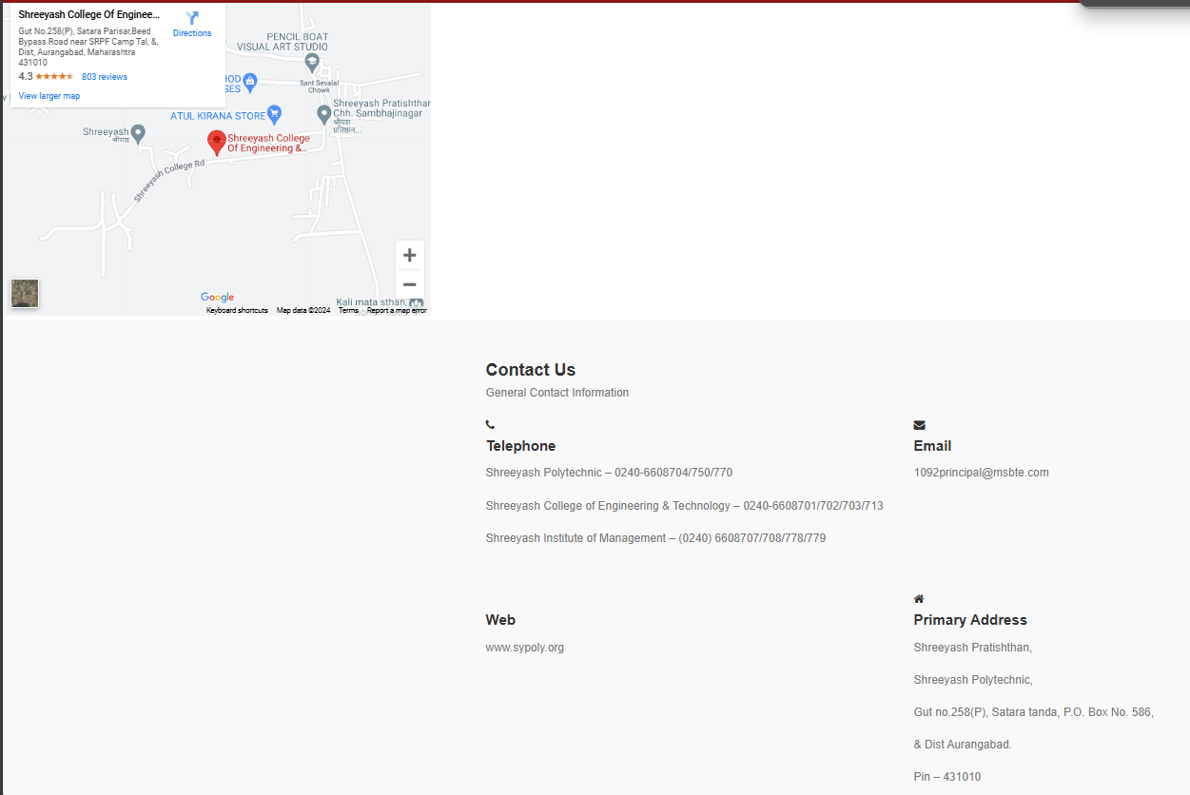
Google Maps Location:
Embedded Google Maps location for easy navigation and finding the institution.
Displays contact information for Shreeyash Pratishthan, including telephone numbers, email addresses, website URL, and primary address. Additionally, it includes a Google Maps location.

Slide 8
THANKS

